Slide 1
CSE4004 – Web Technologies
HTML

Slide 2
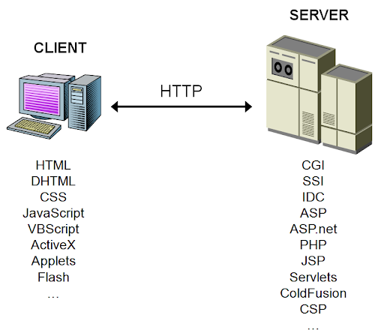
Web Client and Server Programming

Slide 3
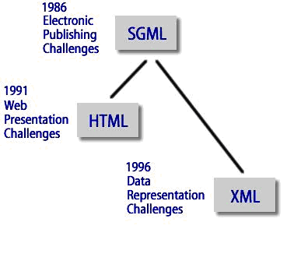
Markup language
defines the structure and content of hypertext documents

Slide 4
HTML Features
Meta tags
Include Scripts (Javascript or VB Script)
Include Styles (Internal/external)
Include audio/video in a page
Create Hyperlinks/anchors
Create ordered and unordered lists
Create frames
Create tables
DIV tag to organize pages
Create Maps
Create Forms

Slide 5
Meta tags
The <meta> tag defines metadata about an HTML document.
Metadata is data (information) about data.
<meta> tags always go inside the <head> element
Typically used to specify character set, page description, keywords, author of the document, and viewport settings.
  <meta charset="UTF-8">
  <meta name="description" content="Free Web tutorials">
  <meta name="keywords" content="HTML, CSS, JavaScript">
  <meta name="author" content="John Doe">
  <meta name="viewport" content="width=device-width, initial-scale=1.0">

Slide 6
Hyperlinks/anchors
The <a> tag defines a hyperlink, which is used to link from one page to another.
The most important attribute of the <a> element is the href attribute, which indicates the link's destination.
By default, links will appear as follows in all browsers:
  An unvisited link is underlined and blue
  A visited link is underlined and purple
  An active link is underlined and red
  <a href=“https://vitap.ac.in”>VIT-AP Official WebSite</a>
  <a href=“contact.htm”>contact us</a>

Slide 7
Hyper link to same page
  Using # and id
    <a href="#top">Top</a>
    <a href="#bottom">Bottom</a>
    <p id=“bottom">Hyperlinks are utilized by a web browser to move from one page to another...</p>

Slide 8
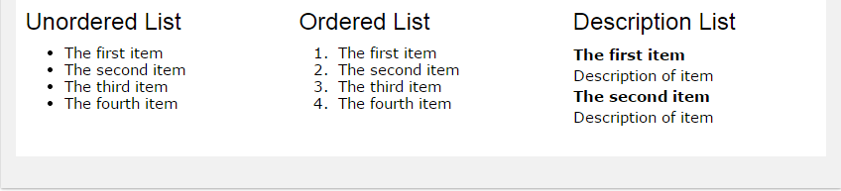
Lists in HTML
The <li> tag defines a list item.
The <li> tag is used inside ordered lists(<ol>), unordered lists (<ul>),description list (<dl>) and in menu lists (<menu>).
In <ul> and <menu>, the list items will usually be displayed with bullet points.
In <ol>, the list items will usually be displayed with numbers or letters.

Slide 9
Ordered and unordered lists
An ordered list starts with the <ol> tag. Each list item starts with the <li> tag.
    type attribute – 1, A, a, I, i
An unordered list starts with the <ul> tag. Each list item starts with the <li> tag
    list-style-type – disc , circle, square , none
        <ul>
        <li>Coffee</li>
        <li>Tea</li>
        <li>Milk</li>
        </ul>
<ol>
<li>Coffee</li>
<li>Tea</li>
<li>Milk</li>
</ol>

Slide 10

Description Lists
A description list is a list of terms, with a description of each term.
    <dl>
    <dt><b>Coffee:</b></dt>
    <dd>black hot drink</dd>
    <dt><b>Milk:</b></dt>
    <dd>white cold drink</dd>
    </dl>

Slide 11
Frames
The <frame> tag was used in HTML 4 to define one particular window (frame) within a <frameset>.
      <frameset cols = "25%,50%,25%">
      <frame name = "left" src = "/html/top_frame.htm" />
      <frame name = "center" src = "/html/main_frame.htm" />
      <frame name = "right" src = "/html/bottom_frame.htm" />
      <noframes>
      <body>Your browser does not support frames.</body>
      </noframes>
      </frameset>

Slide 12
iframe
<iframe> tag to embed another document within the current HTML document.
    <iframe src=“www.HTMLSamples.com" title=“Sample HTML Page">
    </iframe>

Slide 13
HTML
Sample HTML pages

Slide 14
What’s Ahead?
CSS
Client Side Scripting
Server Side Scripting
Web Frameworks

